Slide 1
2023 - PACE Renewal Agent Update Forum
Risk Management Review

Slide 2
Risk Management’s Mission
The risk management department’s mission is to identify our members’ needs and provide the tools and resources to assist them in implementing strategies for preventing and mitigating losses.

Slide 3
Risk Management Services
Property Walkthroughs
In-Person Trainings
Regional Trainings
Quick Reference Guides/Checklists
Webinars
SafeSchools Training
Cyber
Sex abuse prevention
Special education
Hazard Assessments

Slide 4
PACE Self Assessment Tool
Education
Sex Abuse Prevention
Cyber Security
Property
Survey

Slide 5
SAM Prevention Poster

Slide 6
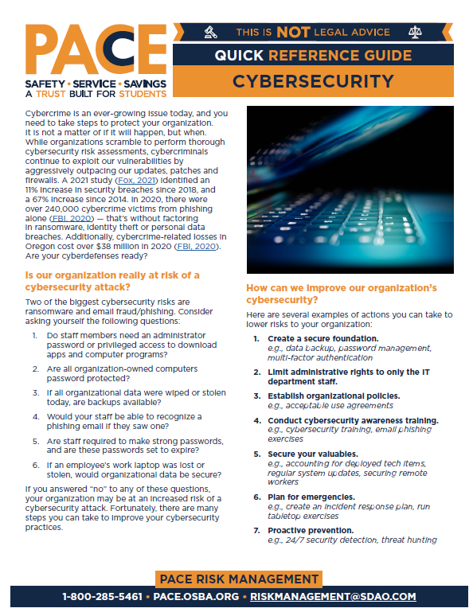
CYBER Security

Slide 7
Key Contact
Most Valuable Person

Slide 8
riskmanagement@sdao.com

