Slide 1
Returning to “Normal” in 2022
Presented by:
Kyle T. Abraham, Shareholder
Ogletree Deakins
February 10, 2022

Slide 2
Legal Disclaimer
The information provided on this website does not, and is not intended to, constitute legal advice; instead, all information, content, and materials available on this site are for general informational purposes only.

Slide 3
Program Overview
“Making the case” for some remote work as “normal” in 2022
Does your future including remote work on a permanent basis?
Legal limits of requiring in-person work
Review of the EEOC Guidance and case law on remote work
“Hypothetical” employee request, and the interactive process
Practical considerations about remote work
Creating a Remote Work Agreement
Protecting Company Data
Avoiding Wage and Hour Issues
Oregon employment and labor law update

Slide 4
Vaccination Mandate

Slide 5
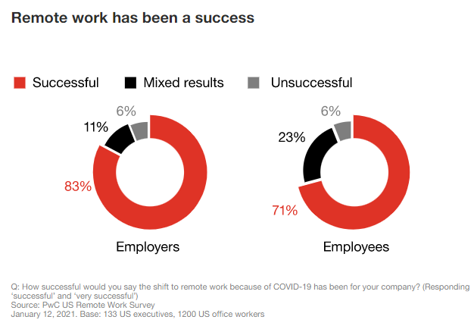
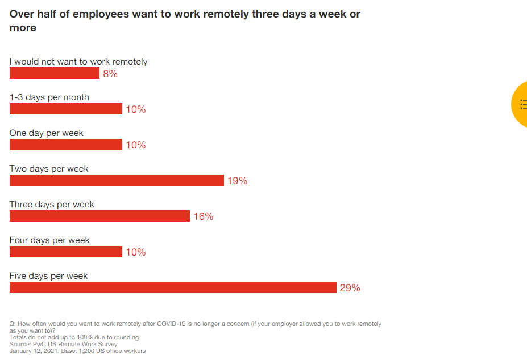
Making the Case for Remote Work
Notes:
These two graphics are taken from Price Waterhouse Coopers survey of companies, which I will discuss further in the next slide. But they show that remote work has been a relative success. Remote work can improve job satisfaction, raise productivity, reduce emissions, and improve access for those with disabilities and living in rural areas.
Even before the pandemic, some of the US workforce was working from home. Massive increase with the pandemic.
Employees are now demanding it. As you can see, the PWC showed that over half of employees that are able to work remotely want to do so at least three days a week.
Global Workplace Analytics estimates that 56% of US workforce holds a job that is at least partially compatible with remote work. They forecast that 25-30% of the US workforce will be working from home one or more days a week after the pandemic.

Slide 6
Key Findings from the Experts
Remote work has been overall more successful than expected
There is no clear answer on how much remote work is the right amount of remote work
Remote work is not as successful for the less experienced employees
Meetings with an emotional component need to be in-person
You may need an office space, but its size and role will change
Notes:
Study surveyed 133 executives and 1200 office workers in November and December 2020.
Remote work has been an overwhelming success
83% of employers now say the shift to remote work has been successful, compared to 73% surveyed in June 2020
Productivity improved over prolonged work from home period
The office is here to stay, but its role is going to change
87% of employers say most important role of the office is for collaborating with team members and building relationships, not providing space to work.
Least experienced workers need the office the most
30% of workers with 0-5 years of experience want to be remote no more than one day a week and 34% of them feel less productive at home
Real estate strategy will shift
87% of executives expect to make changes to their real estate strategy including consolidating office space is premier locations and/or opening more satellite locations.
There’s no consensus on the optimal balance of work days at home vs. in the office
55% of employees want to work remotely at least 3 days a week, while 68% of executives think an employee should be in the office at least 3 days a week

Slide 7
What the Experts are Saying We Experienced
Employees are demanding to work from home
Employers are less fearful of employees working form home
Employer see the potential cost savings when employees work from home
Reduced business travel
Employers recognized business can function when employees work from home
Notes:
This was taken from Global Workplace Analytics study.
Increased demand for work-from-home employees
Over a third would take a pay cut in exchange for the option
Reduced fear about work from home among managers and executives
Trust – how do you know your workers are working? Counting butts in seats is not managing, it’s babysitting. Instead, look at results.
Increased awareness of cost saving opportunities in work from home
Each employee working from home can save a business $11,000 a year. It saves the employee anywhere from $2,500-$4,000.
Increased awareness of the potential impact of work from home on sustainability
Dramatic reduction in traffic, congestion and pollution. Is this something your employees care about? Annual environmental impact of half time remote work for those able would be the greenhouse gas equivalent of taking the entire NY state workforce off the road.
Reduced business travel
This was taken from Global Workplace Analytics

Slide 8
Remote Work Presents an Opportunity
Retention and recruitment is a big challenge
Oregon unemployment in December 4.1%, down from13.2% in April 2020%
US resignation rate in November was about 3%
Employees want remote work arrangements
Question: can you “lead” the market on offering remote work?

Slide 9
Remote Work Presents an Opportunity
Brain storming ideas
How can we move the “home office” perks into the regular office?
Can we offer a hybrid work from home schedule?
How do we balance employee job duties require in-person work versus employees who have flexibility to work remotely.

Slide 10
Case law and EEOC Guidance on Remote Work

Slide 11
Legal Authorities on Remote Work
EEOC Guidance (from 2004)
The ADA does not require an employer to offer remote work to all employees
Remote work may be a reasonable accommodation
After a request from the employee, engage in an "interactive process"
Determine the feasibility of working at home
https://www.eeoc.gov/laws/guidance/work-hometelework-reasonable-accommodation

Slide 12
Is Being Physically Present an Essential Function?
Samper v. Provident St. Vincent Med. Ctr., 675 F.3d 1233 (9th Cir. 2012)
Plaintiff, neonatal nurse, had fibromyalgia, and missed a LOT of work over a period of several years. Plaintiff was terminated for attendance issues.
Plaintiff argued her absences were due to her disability in violation of the ADA .
Defendant argued regular in person attendance is an essential function.

Slide 13
Is Being Physically Present an Essential Function?
Samper v. Provident St. Vincent Med. Ctr., 675 F.3d 1233 (9th Cir. 2012)
Court cited a number of cases holding attendance is an essential functions, if:
The position may require work as “part of a team.”
The position require face-to-face interaction with clients and other employees
The job require the employee to work with items and equipment that are on site.
The Court held, “The common-sense notion that on-site regular attendance is an essential job function could hardly be more illustrative than in the context of a neo-natal nurse.”

Slide 14
Is Being Physically Present an Essential Function?
Mosby-Meachem v. Memphis Light, Gas & Water Div., 883 F.3d 595 (6th Cir. 2018)
Plaintiff was an in-house attorney, with a focus on labor, employment, and workers’ compensation issues.
GC sent an email to legal department:
“Please be reminded that office hours for the Legal Department are 8:30 a.m.–5:00 p.m. Monday through Friday. All employees, including the lawyers, are expected to be at work and devoting their time and attention to Division business during those hours.”
Plaintiff had some complication with her pregnancy at 24 weeks, and she asked to work from home for 10 weeks.
Employer denied the request based on a determination that physical presence was an essential function of the job and concerns about maintaining confidentiality.

Slide 15
Is Being Physically Present an Essential Function?
Mosby-Meachem v. Memphis Light, Gas & Water Div., 883 F.3d 595 (6th Cir. 2018)
Plaintiff argued she could have preformed all the essential functions of the job for the 10 week period from home, and the employer violated the ADA.
Defendant argued in-person attendance was necessary for plaintiff to do the essential functions of the job.
Court held plaintiff demonstrated she could perform all the essential functions of her job remotely for ten weeks. The Court relied on the fact that plaintiff never before tried a case or made court appearances.

Slide 16
Key Take Aways
Courts holds that in-person attendance is an essential function for “most jobs,” but not all jobs.
Determining whether in-person attendance is an essential function is a “highly fact-specific” exercise.
Cases will turn on:
the duration of the remote work request;
ii) a demonstration that other essential functions can be completed remotely.
Even during the pandemic, Courts will uphold a termination if the employer can demonstrate in-person attendance is essential.

Slide 17
Time for a Hypothetical

Slide 18
Hypothetical:
Dinder Mufflin has been working from home since March 2020. Its stayed afloat, but the sales are dropping significantly.
Your CEO, David Malice, wants employees to return to the office within the month.
Toby Flenderson, a mid level HR manager has been working from home since March 2020.
Toby sent you a letter from his medical provider…

Slide 19
Letter from Toby’s provider:
“Toby is a patient of mine. He has been working remotely for almost 2 years. As his doctor, I don’t believe this is in the best interest of Toby’s health to return to the office because of pre-existing medical issues.
Toby is vaccinated, but being in public spaces and commuting on public transportation are risky activities for Toby. Due to his pre-existing health conditions, being around individuals with unknown vaccination status could cause him unnecessary and harmful stress, exacerbating his pre-existing conditions.
My recommendation is that Toby be allowed to continue to conduct his work duties form home. It would be best for Toby if this was a permanent arrangement, if possible.”
Break out discussion: How do you respond to Toby?

Slide 20
Interactive Process Reminder

Slide 21
Do a little fact finding
Get the basic facts about the medical condition (reason) that requires a change in the way a job is performed.
Ask why is it necessary and for how long the employee is asking to work from home.
Understand how the job can be performed from home.
Brainstorm possible changes in the workplace that could enable the employee to perform onsite.

Slide 22
Engage in a “Meaningful” Interactive Process
Come without a pre-determined outcome.
Offer other accommodations to the employee.
For example:
Partial Remote Work
Enhance safety measures at work
Decrease contact with others in the office by shifting workspace/schedule
Unpaid time off under ADA or FMLA

Slide 23
Determine if in-person attendance is essential
Discussions with managers about what the job actually does
Fact specific inquiry, identify why in person work is essential
Teamwork/collaboration
Special equipment
Supervision
Interactions with customers, vendors, etc.
Assess employee performance to date
Consider changed circumstances since the pandemic started

Slide 24
Let’s Return to Toby
1: Find out the Facts
2: Interactive Process
3: In-person Essential?
Anxiety diagnosis
Toby would like to work from home permanently
This would help Toby not be as anxious and uncomfortable
Already have a doctor’s note
Dinder Mufflin is prepared to offer 4 weeks of leave as a transition period
Would having Toby in his own office help ease his anxiety?
Would having a split schedule help ease his anxiety?
David Malice wants managers in the building for morale and to set a good example to other employees
Is Toby on a team?
Does Toby need to meet with employees? about topics with an emotional element?
Notes:
So, let’s go through the four step process for Toby.
Don’t forget to document everything!

Slide 25
Creating a Policy and Agreement

Slide 26
Key Provisions
Eligibility for Telework
Subject to Revision
Confidentiality and IT Capability
Protecting Company Data
Not a Substitute for Family Care, PTO, or Leave
Workplace Safety
Communication
Reasonable Accommodations
Equipment and Reimbursement
Timekeeping
Wage and Hour Issues
Notes:
Mandate VPN Use
Implement Reputable Software
Set Clear Expectations and Communicate with Employees
Use Multifactor Authentication for Mobile Devices
Offer Basic Security Training
Limit Personal Device Use
Keep Software and Devices Up to Date
Consult an Expert
Encrypt all Laptops
Install Anti- Malware Software

Slide 27
Cybersecurity in the Remote Workplace
Podcast for you to check out!
https://ogletree.com/podcasts/2022-01-20/cybersecurity-in-the-remote-workplace-in-international-workplaces-during-the-covid-19-pandemic

Slide 28
Avoiding Wage and Hour Pitfalls
Reiterate timekeeping policies
Set schedules
Identify and address gaps in timekeeping system
Require employees to certify their time
Remember meal and rest requirements
Pay attention to expenses
Notes:
Reiterate timekeeping policies
Remind non-exempt employees in writing that timekeeping policies apply with the same force as before.
Set schedules
Employees who had a set schedule in the office should stick to a schedule at home. Involve employees in setting a schedule that works for them but hold them to it.
Identify and address gaps in timekeeping system
Require employees to certify their time
Have them certify that their submission is accurate and reflects actual hours worked. This would be a great exhibit in the event of a future lawsuit.
Remember meal and rest requirements
These laws apply equally in the WFH context. Remind your employees to abide by meal and rest period policies even at home
Pay attention to expenses
If non-exempt employees incur costs as a result of WFH (buying printer, adding a phone line) make sure it doesn't reduce their pay below minimum age or cut into overtime compensation
Listen!
Open communication for these issues now more than ever. Be prepared to act quickly to address issues.

Slide 29
Employment and Labor Law Update
It is now a disability
State of the vaccine mandates

Slide 30
Expanded Definition of “Race” for Discrimination Claims
Expanded race as a protected class to include “physical characteristics that are historically associated with race, including but not limited to natural hair, hair texture, hair type and protective hairstyles.” (HB 2935)
Notes:
“Protective hairstyles” defined to include any “hairstyle, hair color or manner of wearing hair that includes, but is not limited to, braids, regardless of whether the braids are created with extensions or styled with adornments, locs and twists.”
Already need to on a case-by-case basis make reasonable accommodation of an individual based on the health and safety needs of the individual from dress code policy.
Existing Oregon law prohibiting race discrimination in employment may already prohibit discriminatory conduct or disproportionate impact based on race-related hairstyles or other physical characteristics. The CROWN Act explicitly confirms such protections. Oregon employers that have not done so already may want to take steps to ensure that their antidiscrimination and dress and grooming codes, policies, practices, and trainings comply with these provisions by January 1, 2022.

Slide 31
Limits on Employee Driver’s License Requirements
It is now an unlawful employment practice to require employees to have a driver license as a condition for employment or continuation of employment unless
driving is an essential job duty; or
is related to a legitimate business purpose. (SB 569)

Slide 32
Additions to the Oregon Family Leave Act
Changes to OFLA during a Public Health Emergency
Reduced waiting period for eligibility to 30 days
Credit for time worked if re-employed within 180 days
Continued reason for leave to include caring for a child who requires home care due to
Notes:
Expands applicability of certain provisions relating to family leave to employers who employ one or more employees.] Expands eligibility for protected leave under Oregon Family Leave Act to all employees of covered employer during public health emergency unless employee was employed for fewer than 30 days prior to commencing leave or worked average of less than 25 hours per week in 30 days prior to commencing leave. Establishes eligibility to take leave for employees who separate from employment, are eligible at time of separation and are reemployed within 180 days of separation, or for employees who are eligible at beginning of temporary cessation of scheduled hours of 180 days or less and who return to work at end of cessation period. Allows for restoration of time worked by employee when employee returns to work after separation or temporary cessation period. Includes closure of child care provider or school due to public health emergency as qualifying purpose for which leave may be taken. Allows employers to request verification for need for leave due to such closure. Reduces amount of time employee must work for employer before becoming eligible to take leave. Eliminates disciplinary action that may be imposed upon employee for employee's failure to comply with leave notice requirements. Allows employee to determine order in which employee may choose to use accrued leave.] Removes gendered language from provisions related to pregnancy.

Slide 33
Pay Equity Fix for Certain Incentives
No pay equity violations based on incentive pay related to a public health emergency:
Exempts vaccine incentives from the definition of “compensation”
Temporarily exempts hiring and retention bonuses from the definition of “compensation”
Notes:
Oregon Pay Equity Law defines compensation broadly.
Earlier this year, concern arose that paying certain vaccine and/or retention incentives during the COVID-19 pandemic could potentially be construed to discriminate against certain groups or violate the Pay Equity Law.
BOLI has actually taken that position on its website, cautioning employers that incentives could violate the law.
Business lobby was able to get fixes passed to clarify that vaccine incentives do not violate – and that will already be in place to apply to any future vaccine for a future public health emergency.
Exemption for hiring/retention bonuses – in response to difficulties employers have had reopening – are temporary to this public health emergency. But no reason to think something similar wouldn’t pass if a similar situation arose during another state of emergency now that this precedent exists.

Slide 34
Treasure Valley Education v. Treasure Valley Communication College – Arbitrator Runkel
A tenured agricultural instructor wanted to use college’s welder to improve his welding skills
An email exchange between the instructor and the Dean resulted in the Dean informing he instructor that “[he] can’t let welders leave campus”
The instructor moved the welder from the college’s property to his own
He was terminated for theft and insubordination. He brought a grievance under the CBA for his termination
Issue: did college have just cause to terminate a tenured employee?
CBA
Tenured Status
“No tenured faculty member shall be disciplined, suspended, reduced in compensation, or dismissed without just cause and due process as outlined in this agreement.”
Notes:
The instructor also alleges that after the email exchange, he had a phone conversation where the Dean gave him permission to take the welder off campus. The dean denies this conversation occurred.
When the Dean realized the welder was gone, he contacted the police. The police contacted the instructor, and the instructor explained that his rationale for taking the welder was that he wanted to build a trailer for it.
The instructor alleges the pair had a phone conversation where the instructor told the Dean he wanted to build a trailer for the welder. The Dean denies this phone conversation ever happened.

Slide 35
Arbitrator Runkel’s Decision
Applied a 3 Element “Just Cause” Standard in Denying the Grievance
Whether the employer has proved the alleged wrongdoing;
The Arbitrator found the Dean’s version of events more credible
Whether the employer provided the fundamental of due process, including conducting a fair investigation; and
Termination decision must be examined from the “standpoint of the evidence that was available and relied upon at the time the termination decision was made, and not on evidence that came to light at a later time.”
Practice Tip: Shoot the corpse
Whether the level of discipline imposed was proportionate to the seriousness of the wrongdoing
Not withstanding a clear discipline record, theft is “one of the most serious offenses an employee can commit” and “justifies termination of employment without following any progressive discipline steps.”
Notes:
The board found the dean’s versions of events more credible primarily because there was no indication of why the dean would change his mind about permitting the instructor to take the welder off of campus so shortly after the initial email exchange. The Board also found that the fact that the instructor did not tell anyone he took the welder off campus “raises a red flag.”
The VP of College assigned director of HR to investigate the situation. HR director met with both parties, gathered written statements, took photos, obtained the emails and submitted a written report. The Board noted that through this investigation, the instructor had “ample time” to present his version of events and concluded the investigation was reasonable.
The grievance award ws denied.

Slide 36
Oregon State Police Officers Ass’n v. State of Oregon - UP-038-21
The Union alleges the State violated the duty to bargain over changes in employment terms and conditions required by EO 21-29 – the Vaccine Mandate for State Employees
The State admitted that it implemented the EO before completing impact bargaining
State’s position was that the EO carried the “full force of law” and any proposal contrary to the EO was a prohibited subject
The Union also argued that EO 21-29 impairs CBA in violation of Contract Clause of state and federal constitutions
Notes:
EO 21-29 was Governor Brown’s Executive Order requiring executive branch employees to be fully vaccinated against COVID-19.
The union wanted to bargain over (1) the implementation date (2) the consequences for an employee who fails to meet the deadline and (3) the basis for exemptions.
The state responded that they would bargain the impact but not the decision itself.
As of the date of hearing, the state and union had met twice to bargain over the impacts. A union that represents a different bargaining unit of executive branch employees proposed, and the governor approved, of a grace period proposal. The employees who were not fully vaccinated by Oct 18 were permitted to work remotely if possible or be on leave (use paid leave if available). The state made it clear that they would agree to the same grace period for this union.

Slide 37
ERB Analysis
A proposal is a prohibited subject if “it is specifically contrary to a statute or would require a party to act contrary to a statute”
The Board evaluated the Governor’s authority
During a state of emergency, the governor has “complete authority over all executive agencies of state government and the right to exercise… all police powers vested in the state by the Oregon Constitution”
EOs issues during a state of emergency have the full force and effect of law both during and after the emergency
Even if there was a conflict between PECBA and EO, the EO controls and the State does not violate PECBA
Notes:
The board found that when issuing the EO, the governor was exercising the state’s police power to “protect state workers, their coworkers and the public that relies on state services” from COVID-19.
Union argued EO 21-29 impairs CBA which “reserves to the Association the right to negotiate over changes in conditions in employment.” The CBA also provides that “The employer is not limited, confined, or restricted by past practice, rule, custom, or regulation in making changes in policies, procedures, rules, and regulations to carry out the mission of the Department”
CBA also expressly limited to scope of bargaining to those the employer is compelled to negotiate by state law

Slide 38
Questions?

Slide 39
Thank you!
Kyle T. Abraham
Ogletree, Deakins, Nash, Smoak & Stewart, P.C.
222 SW Columbia Street, Suite 1500 | Portland, OR 97201
kyle.abraham@ogletree.com
Phone: 503-552-2177

