Slide 1
2021 SDIS Health
Plan Renewal
February 19, 2021

Slide 2
AGENDA
Health Plan Renewal Overview
SDIS Program Enrichments Effective July 1
Prescription Drug – transition to Regence
Delta Dental Plan Enrichment
NEW- Adding Cascade Centers EAP
NEW- Adding Voluntary Life Insurance
Notes:
To change the image on this slide, select the picture and delete it. Then click the Pictures icon in the placeholder to insert your own image.

Slide 3
Health Plan Renewal Overview
Notes:
To change the image on this slide, select the picture and delete it. Then click the Pictures icon in the placeholder to insert your own image.

Slide 4
HEALTH PLAN RENEWAL
SDIS self-funded medical/rx/vision plan requires an overall 10.5% increase
Your district’s renewal may be higher or lower, depending on your plan enrollment
SDIS is utilizing its surplus earnings to reduce the average rate increase from what would have been a 14% increase.
GOOD NEWS! No changes to the plans or reductions in coverage on top of rate action
Delta Dental Plan rates increasing by 2%: Willamette Dental plan rates will not change
No reductions in coverage- see Delta Dental enhancement to follow
Notes:
To change the image on this slide, select the picture and delete it. Then click the Pictures icon in the placeholder to insert your own image.

Slide 5
HEALTH PLAN RENEWAL
Health Insurance rate increase continues to be driven by large claims and prescription costs
1.4% of claimants account for 45% of costs
Prescription costs have been increasing by an average of 17% annually
SDIS has the lowest prescription co-pay for specialty drugs than any other plan
Moving pharmacy from Caremark to Regence will save the SDIS plan money and also improve coordination of benefits
Notes:
To change the image on this slide, select the picture and delete it. Then click the Pictures icon in the placeholder to insert your own image.

Slide 6
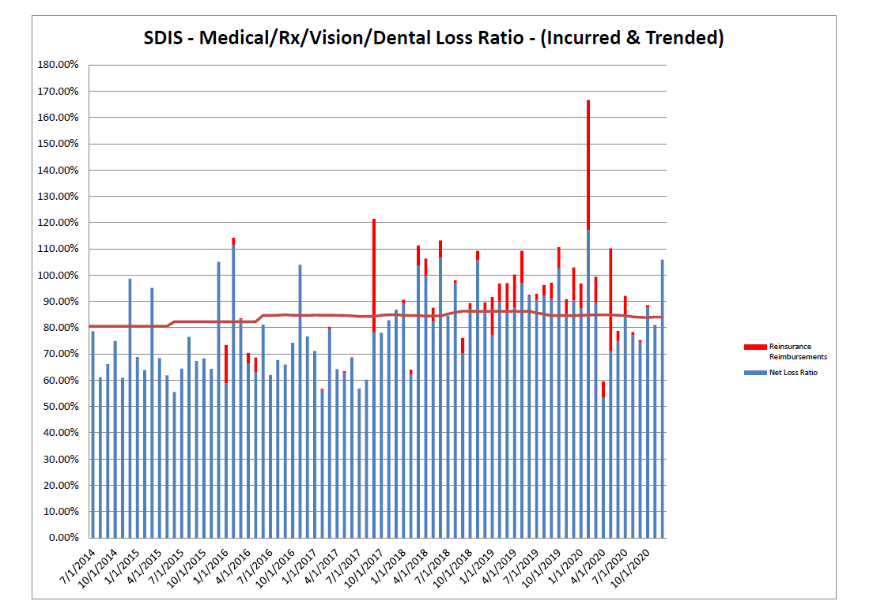
HEALTH PLAN RENEWAL
Notes:
To change the image on this slide, select the picture and delete it. Then click the Pictures icon in the placeholder to insert your own image.

Slide 7
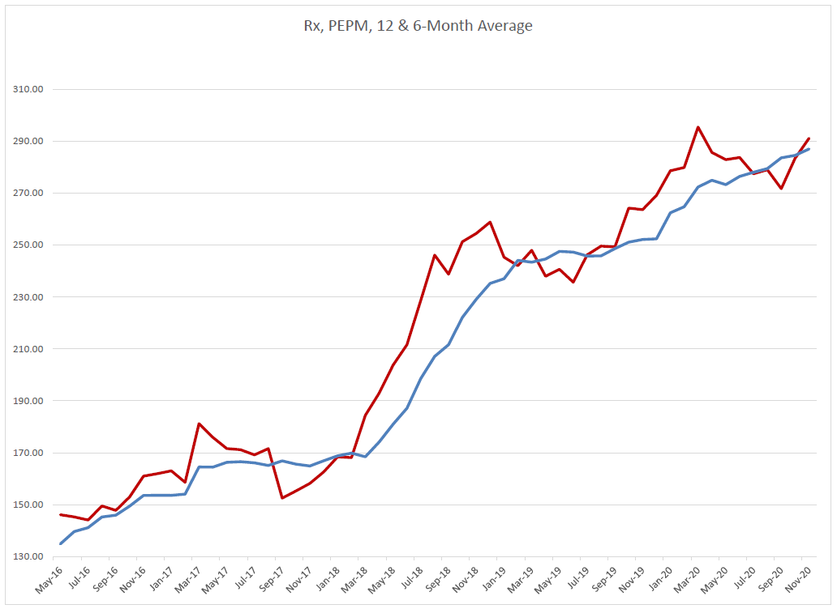
HEALTH PLAN RENEWAL
Notes:
To change the image on this slide, select the picture and delete it. Then click the Pictures icon in the placeholder to insert your own image.

Slide 8
SDIS Program Enrichments
Effective July 1
Notes:
To change the image on this slide, select the picture and delete it. Then click the Pictures icon in the placeholder to insert your own image.

Slide 9
PRESCRIPTION DRUG TRANSITION
Prescription coverage is transitioning to Regence, based on a very competitive proposal
This change will make it easier for members when questions arise - one customer service number moving forward
SDIS and TPG already working with Regence to achieve a smooth transition
More details to come as we get closer to July 1!!
Notes:
To change the image on this slide, select the picture and delete it. Then click the Pictures icon in the placeholder to insert your own image.

Slide 10
DELTA DENTAL PLAN ENRICHMENT
As of July 1, any Class 1 services will not apply to the annual plan maximum of $1,500
Class 1 Services include:
Periodic exam/x-rays
Cleanings/periodontal maintenance
Sealants/space maintainers/topical application of fluoride
This change effectively increases dental benefits for Class 2 and Class 3 services
Notes:
To change the image on this slide, select the picture and delete it. Then click the Pictures icon in the placeholder to insert your own image.

Slide 11
NEW- CASCADE CENTERS EAP
SDIS is adding an employee assistance plan (EAP) with Cascade Centers effective July 1
All districts enrolled in an SDIS medical plan (not already covered under the 1st responder EAP) will be eligible for the Cascade Centers programs
There is NO ADDITIONAL CHARGE!
More information to come soon- check renewal packet for the informational webinars scheduled in July!
Notes:
To change the image on this slide, select the picture and delete it. Then click the Pictures icon in the placeholder to insert your own image.

Slide 12
NEW- VOLUNTARY LIFE INSURANCE
Based on member interest and feedback, SDIS is updating its voluntary life and AD&D program with The Standard
New program will offer a ONE-TIME opportunity to buy life insurance with NO medical questions- guaranteed issue
Up to $300,000 available for active employees
Up to $50,000 for spouses, $10,000 for child(ren)
$10,000 increments
Matching AD&D coverage available as a separate choice
Notes:
To change the image on this slide, select the picture and delete it. Then click the Pictures icon in the placeholder to insert your own image.

Slide 13
NEW- VOLUNTARY LIFE INSURANCE
IMPORTANT- IMPORTANT- IMPORTANT
SDIS MUST achieve 20% participation from eligible district employees in order to offer this new program
All districts that are participating in a SDIS plan are eligible
Notes:
To change the image on this slide, select the picture and delete it. Then click the Pictures icon in the placeholder to insert your own image.

Slide 14
More voluntary life plan details:
Existing eligible employees and dependents may only enroll as of July 1- there is no ability to add coverage throughout the year
If an employee doesn’t enroll for 7/1/2021, any coverage added at future renewals will require a medical questionnaire
Life coverage is portable and/or convertible if employee changes employment
Waiver of premium available if covered employee becomes disabled while insured, is under age 60, and completes the 180-day waiting period
Notes:
To change the image on this slide, select the picture and delete it. Then click the Pictures icon in the placeholder to insert your own image.

Slide 15
More voluntary life plan details:
Rates are based on 5-year age bands; premium will increase when a participant moves into a new age band
All participants age 70+ are subject to a life coverage reduction schedule
Death resulting from a suicide within the first 2 years is excluded
Accelerated benefit available if insured becomes terminally ill
Notes:
To change the image on this slide, select the picture and delete it. Then click the Pictures icon in the placeholder to insert your own image.

Slide 16
More voluntary life plan details:
Enrollment forms and rates will be delivered with every renewal packet
Email Shelly or Rey if you’d like to get enrollment information now
SDIS must receive an individual enrollment form from each enrolling employee
SDIS also recommends providing your payroll department with a copy of enrollment forms to initiate payroll deductions
All voluntary life & AD&D enrollment forms must be turned in to Shelly Barker by May 1
Notes:
To change the image on this slide, select the picture and delete it. Then click the Pictures icon in the placeholder to insert your own image.

Slide 17
Thank you for joining us today!
A few closing comments…..
District renewal packets will be delivered to agents on or before March 1
Look for dates and times for regional webinar in March; additional key information shared at this time
Renewals will be delivered to each district on or before April 1
Notes:
To change the image on this slide, select the picture and delete it. Then click the Pictures icon in the placeholder to insert your own image.

Slide 18
Contact information:
Shelly Barker, SDAO
sbarker@sdao.com
Rey Perez, TPG
rperez@tpgrp.com
503.941.4367 delivered to agents on or before March 1
Look for dates and times for regional webinar in March; additional key information shared at this time
Renewals will be delivered to each district on or before April 1
Notes:
To change the image on this slide, select the picture and delete it. Then click the Pictures icon in the placeholder to insert your own image.

Slide 19
Administered By Special Districts Association of Oregon
1.800.285.5461
sdao@sdao.com
For more information about our services available to our member districts, visit:
www.sdao.com

