Slide 1
2023 PACE and WC Underwriting Update
Tuesday, April 18, 2023

Slide 2
Chris Hill Jaime Keeling Emily Knaus Monica Lemke
Underwriting Department-
underwriting@sdao.com
Notes:
New underwriter!
PLEASE use the underwriting@sdao.com email address to contact us!

Slide 3
Agenda
SAIF Transition
PACE Renewal
Property Coverage Changes
Liability Coverage Changes
Cyber Update/Changes
Rate Changes
Underwriting Updates and Reminders

Slide 4
Workers’ Compensation SAIF Transition
Notes:
138 of around 670 members have signed and returned their Service Agreement to continue to receive Risk Management services from SDAO while insured with SAIF
Please reach out to SAIF to begin the application process if you haven’t already been contacted

Slide 5
Safety Net Benefits
Criminal Defense Cost Coverage- $250,000
HIPPA Defense Cost Coverage- $10,000
OSHA Defense Cost Coverage- $10,000
Notes:
Additional Coverages Unique to our program for a 5% Charge-

Slide 6
PC Discount for members enrolled in both SDIS PC and SDAO Service Agreement with SAIF
The total discount amount will be indicated on the SDIS PC Invoice
Notes:
It’s a 4% discount off of GL, Auto and Property even though the invoice only shows reflects on the GL line of the PC Invoice. The total that reflects on the WC decs are truly correct.

Slide 7
Begin the Quote Process
SAIF began accepting applications on 4/1
SAIF already has members’ loss information and mods
Links to more info in the chatbox

Slide 8
PACE Renewal

Slide 9
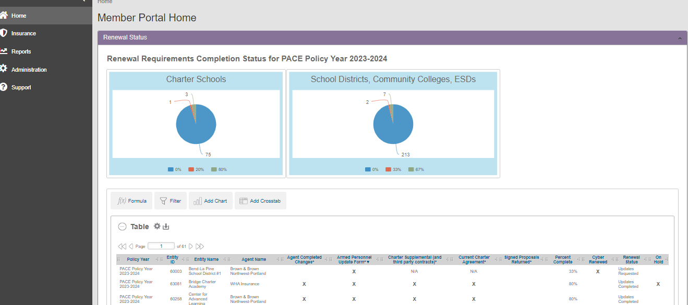
New Renewal Status Dashboard

Slide 10
PACE Legal Engagement Letter
Included in Update Packet
Please have member return to OSBA/PACE Legal
Notes:
Update from Chill

Slide 11
Property
Tiered Property Trend:
Locations with no appraisal date noted or appraisal date >5 years old and no year build details evidencing a year built within last 5 years: +12.5%
Locations appraised or built year in 2018 or 2019: +10%
Locations appraised or year built in 2020: +7.5%
Locations appraised or year built in 2021: +5%
Locations appraised or year built in 2022: +3.5%
Conducted Appraisal
Notes:
Update from Chill

Slide 12
CBIZ Appraisals
Members that were appraised are indicated on the Property Update Schedule
Roughly 1,000 structures appraised this year
Appraised Values included on Property Update Schedule
Please Review Report and Reconcile Any Discrepancies!
Report is uploaded to Insurance Portal
Notes:
Update from Chill

Slide 13
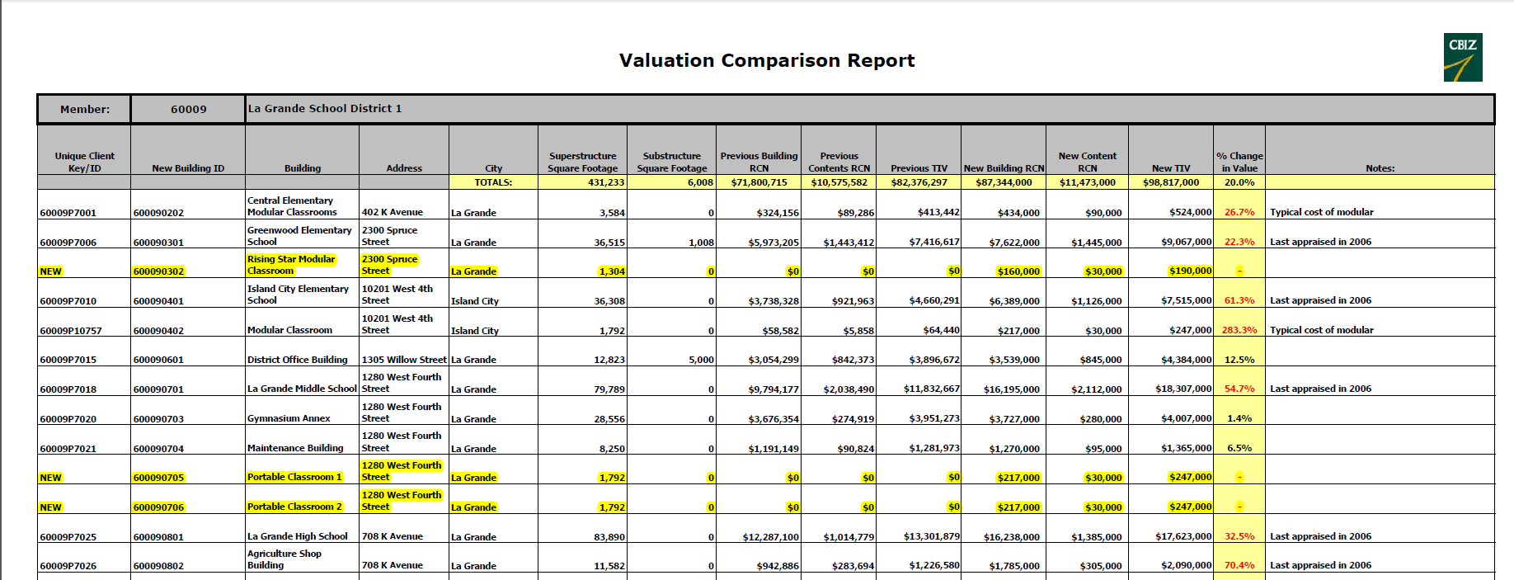

Slide 14
Property – What we’d like help with
Review the color-coded issues identified on the Update Schedule
Review any properties marked as a COC or Remodel to see if projects are completed
Continue to upload property photos to the Portal
Notes:
Update from Chill

Slide 15
CYBER
Notes:
Update from Chill

Slide 16
NEW Cyber Application
Must be completed and have ‘yes’ answers on every question to renew
Application Included in Update Packet

Slide 17
Required to Renew Cyber effective 7/1/2023:
Must be completed by 6/30/2023:
Force domain and email passwords to expire annually
Restrict admin rights on member computers
Back up data daily
Implement a Cyber Incident Response Plan
Add two cyber trainings each to staff and admin training rotation (see PACE Cyber Coverage Underwriting Requirement Memo in Update Packet)

Slide 18
Required to Renew Cyber effective 7/1/2023:
Commit to completing by 6/30/2024:
Implementing multifactor authentication (MFA) for the following logins:
VPN, VDI and RDP (virtual private network, virtual desktop infrastructure and remote desktop protocol), where applicable
Cloud-based business application suites such as Microsoft Office 365 and Google G-Suite
Email (if separate from Office 365 and G-Suite)
Privileged user accounts for the following applications
Student information system
Payroll/HR applications
Accounting or financial applications
Any other system that offers MFA
Deploy Endpoint Protection Software on all Endpoints
All staff complete any 2 of the remaining 6 trainings available on SafeSchools/SafeColleges

Slide 19
Charter Schools
Underwriting Guidelines
Notes:
You’ll see requests for Charter Supplemental and updated charter agreements for those that are expired/expiring.

Slide 20
Charter Requirements
Sponsored by a school district or ODE through a charter agreement.
Operate as a non-profit, 501 (c) (3) corporation with its own board of directors. These must be current with the Oregon Secretary of State Office (may not be true for conversion charter schools).
All charter schools must be registered with the Oregon Department of Education.
No CMO’s or EMO’s.
Only Other is qualified for PACE.
The charter school must be named in the charter agreement.
Named Participant, charter school in the charter agreement, the non-profit registered with the Oregon SOS Office and the Charter registered with the ODE all must match verbatim.
Notes:
Before we quote, will ask for charter agreement and do our research with SOS and ODE.
Management structure,
Names match giving us a clear named insured.

Slide 21
Special Charter School UW Requirements:
Make sure Charter Agreement is up to date
Submit the Charter Supplemental Application with all associated documentation
If they contract with third party that provides staffing or other service that has direct contact with students, we need that agreement
Will analyze components of those agreements and possibly develop underwriting requirements for those next renewal

Slide 22
Liability Coverage Changes
Language Cleanup around Additional Coverages

Slide 23
Property Coverage Changes
Prorate language added to PACE Per Occurrence Aggregate Loss Limit
Ratio of individual Per Occurrence Loss Limit to the sum of all Per Occurrence Loss Limits of affected members applied to PACE Per Occurrence Aggregate Loss Limit
Help to quickly calculate the maximum probable limit so members can apply for FEMA funds ASAP
All members’ maximum probable limit will be same percentage of individual Per Occurrence Limits

Slide 24
Property Coverage Changes
Additional Coverage C . Fungus Resulting from Covered Loss
Currently limit is lesser of $10,000 or 10% of loss
Effective 7/1, dropping the 10% so limit will just be $10,000
Wildfire and the Occurrence Definition
Currently ‘any natural phenomena’ occurring within a 72 hour period, which could make one wildfire multiple occurrences
Effective 7/1, carving out wildfire/fire complex to be own occurrence with no 72-hour ‘rule’

Slide 25
RATES
Notes:
Let’s talk about what’s driving rates

Slide 26
Reinsurance
Increased Property Values
Extremely hard property market (see Cliff’s Presentation)
Liability Reinsurance Costs driven by social inflation in general
Also driven frequency and inflation of SAM claims
Notes:
For years SAM judgements in Oregon have lagged behind California and other parts of the country. Not so anymore. Recent judgement of $3 million.

Slide 27
Members will see an average 16-18% increase this year.
Notes:
Property Reinsurance schematic not yet set, so it’s tough to finalize our pricing
Members with older appraisals will be at or above the high end or this range

Slide 28
Requirements to complete for renewal:
Cyber Application MUST completed if member wants cyber coverage
Armed Personnel Update Form
Make any necessary changes online
For Charters – Charter Supplemental Application
For Charters – Updated/renewed Charter Agreement if expiring or expired
Email to underwriting@sdao.com letting us know that member is ready for renewal
Once the above has been received, we will post Proposal Packets online, which must be returned with signatures

Slide 29
PACE Renewal Timeline May 6 Proposal packets posted online for the members whose agents have confirmed Updates are complete. June 3 Proposal packets posted online, for those remaining members that have not confirmed completion of updates. These packets are renewed per expiring information. Signed proposals and all other required documentation must be returned prior to release of final renewal packet! July 1 Final renewal packets, with invoice and declarations, posted online for those who have returned signed proposals. September 1 Due date for annual contributions.
Notes:
Save the Date for early November for SDIS Agent Update Forum similar to this one.

